Slide 1


The Political Economy of East Asia
(BPEP-SHU 9042)
Monday & Wednesday
3:45 pm – 5:00 pm
Room E201
Instructor: JING QIAN

Slide 2
Logistics
New Development Bank fieldtrip sign-up form due 11:59PM on Sunday, Jan 25
Requests for library workshop
Updated quiz windows (available in online syllabus)
Quiz 1: 8am Sat. Feb 7 – 11:59pm Mon. Feb 9
Quiz 2: 8am Sat. Mar 7 – 11:59pm Mon Mar 9
Quiz 3: 8am Sat. Apr 4 – 11:59pm Mon Apr 6 (Spring break to follow)
Quiz 4: 8am Sat. May 2 – 11:59pm Mon May 4 (Presentations to follow)

Slide 3
Plan
Foundations of (comparative) political economy
How to do a presentation*

Slide 4
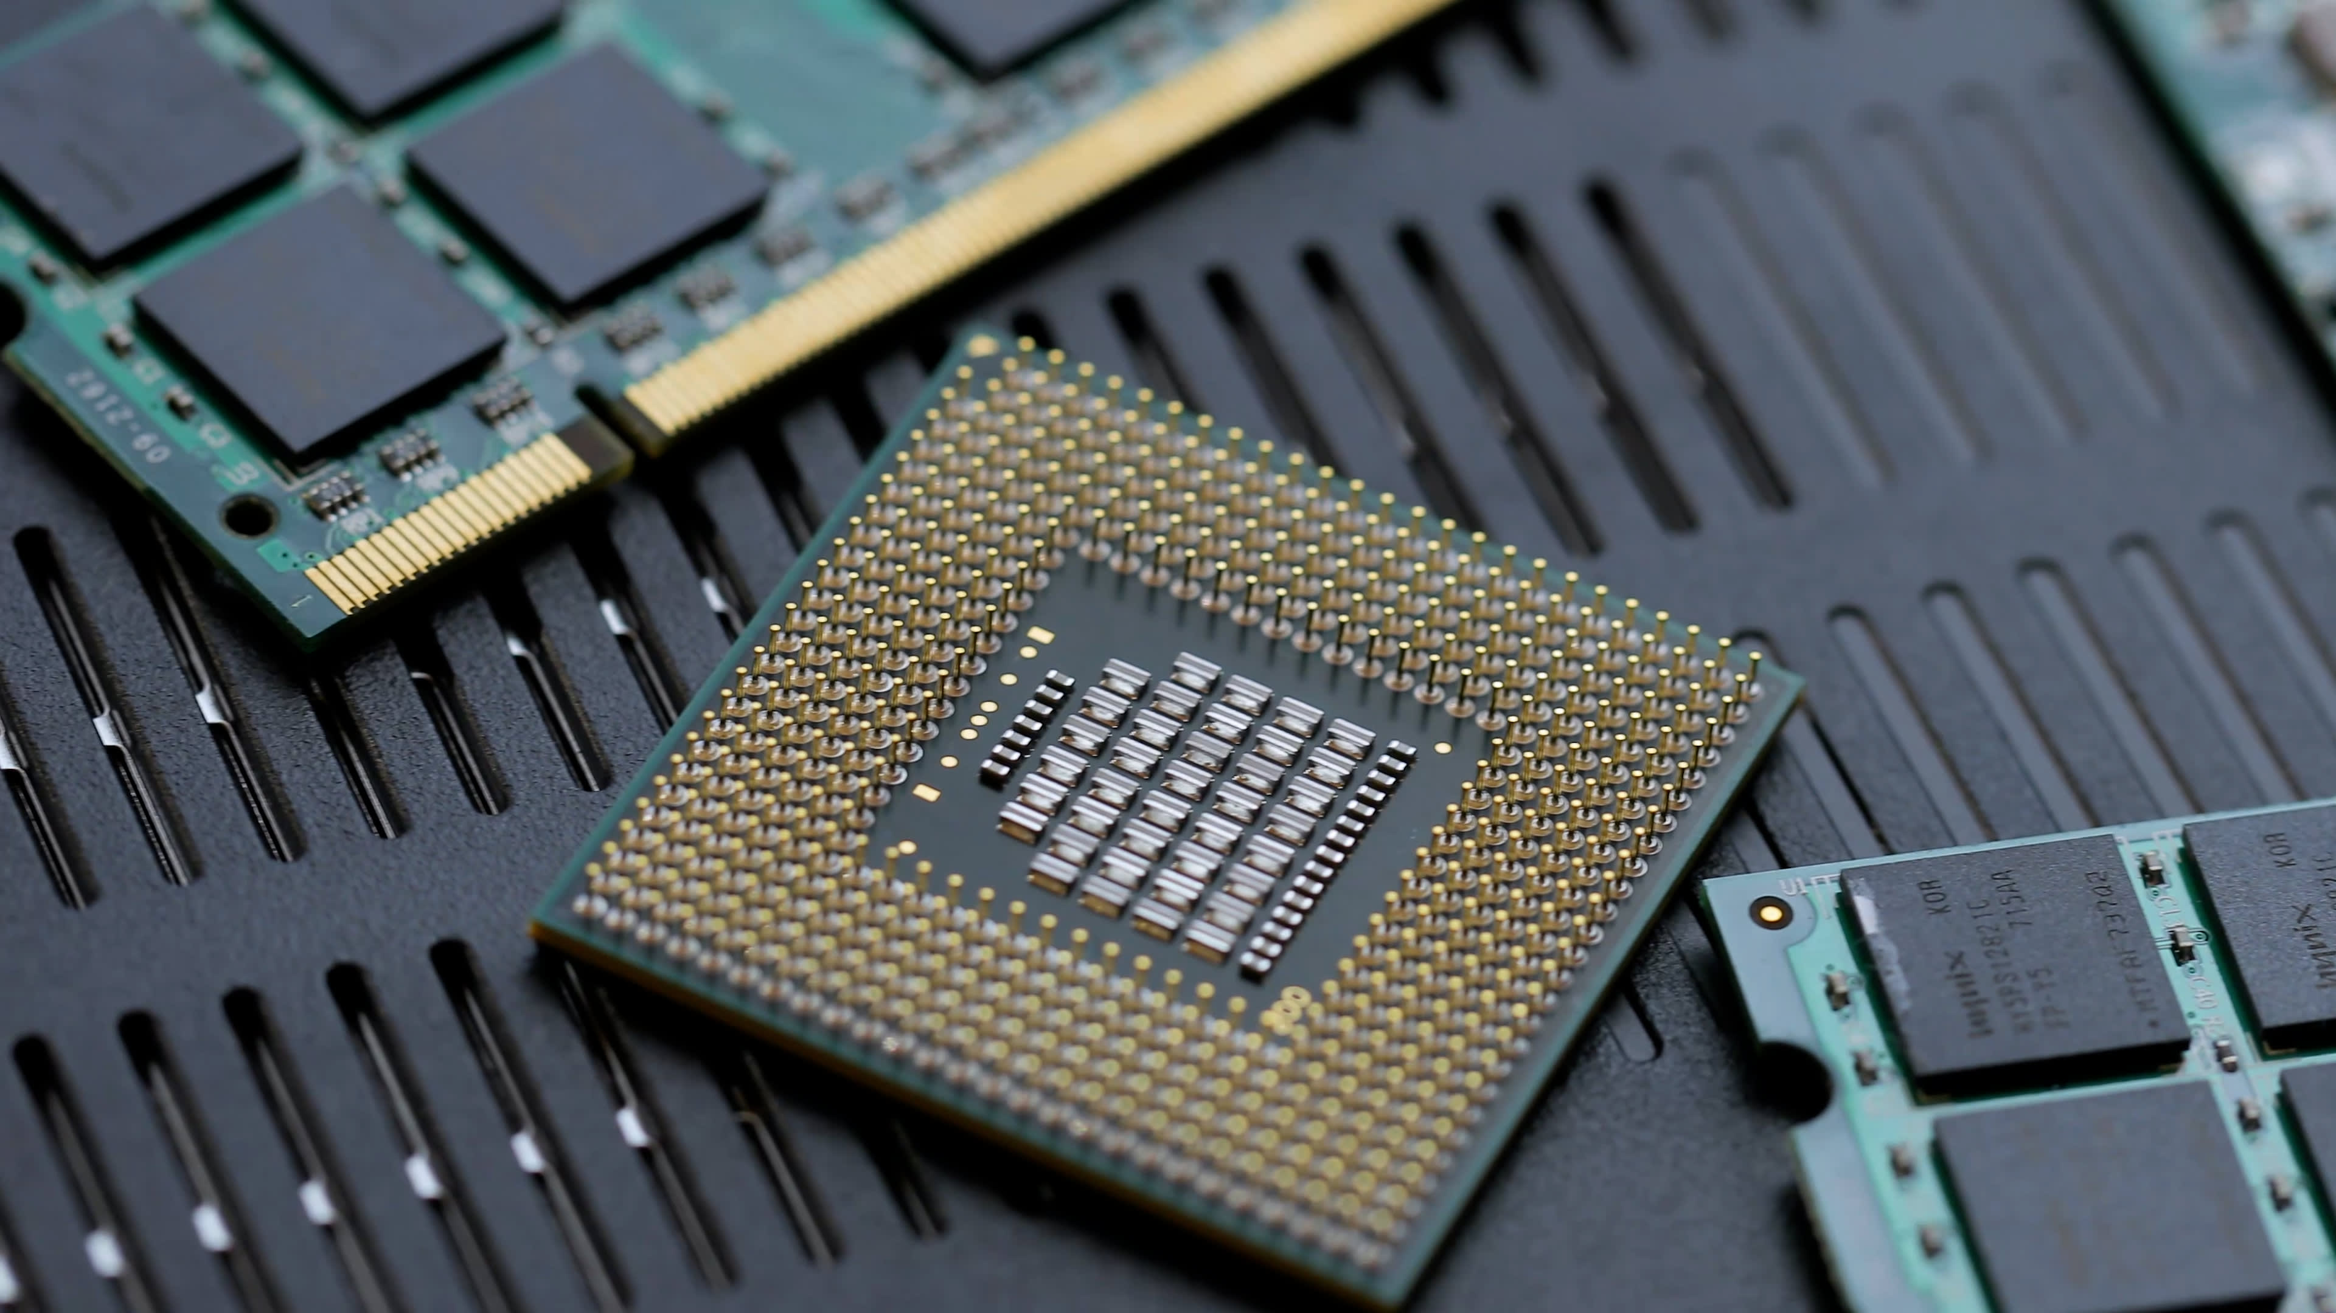
Notes:
https://www.universitywafer.com/how-to-make-computer-chip-silicon.html?srsltid=AfmBOoqS-vpi2U_SPR980O8P1PThDcyRfCaJ77uk1PyzR3hZBXkaCcmF

Slide 5
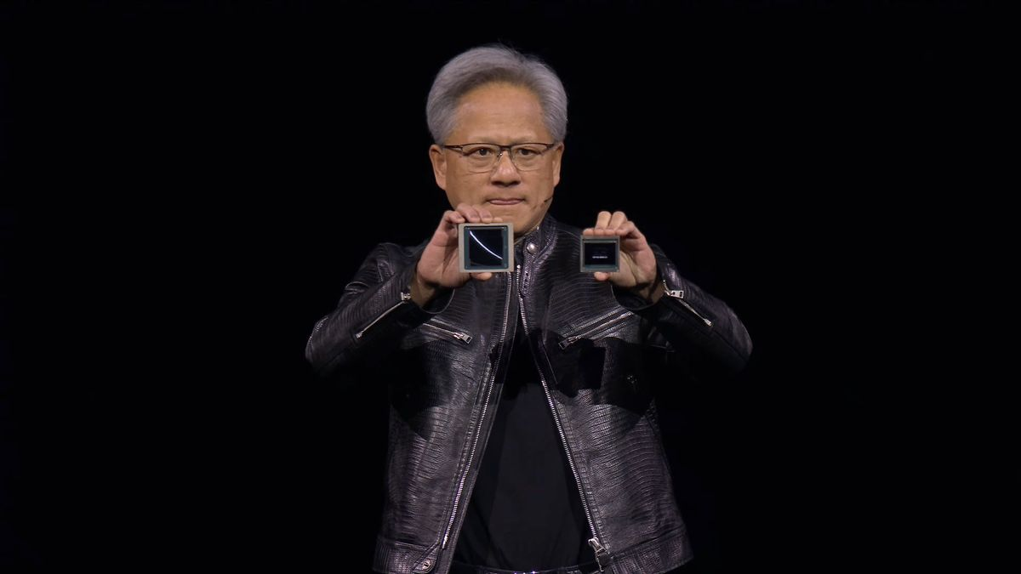
Notes:
https://cdn.mos.cms.futurecdn.net/fc399akkkYrbDG6nSBPNKB-1200-80.jpg

Slide 6


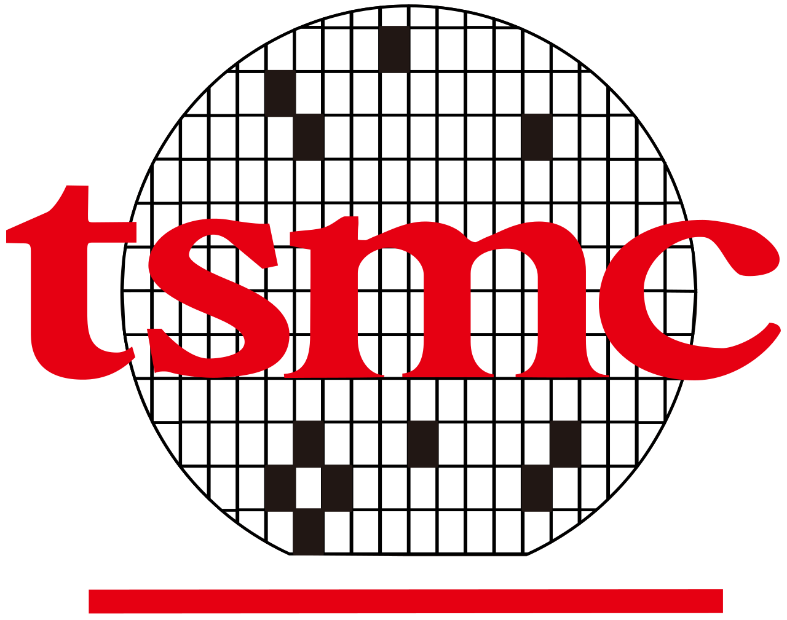
Notes:
https://sco.wikipedia.org/wiki/File:Nvidia_logo.svg
https://en.wikipedia.org/wiki/TSMC

Slide 7
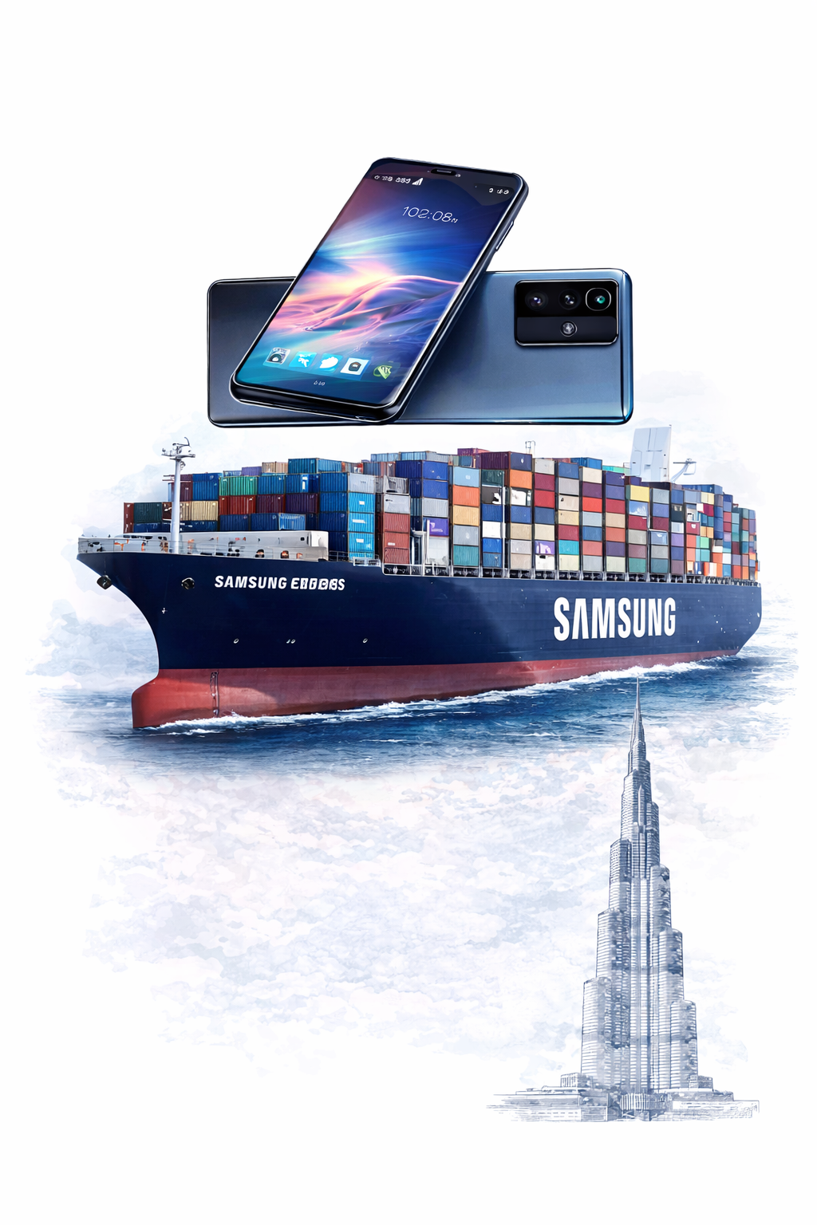
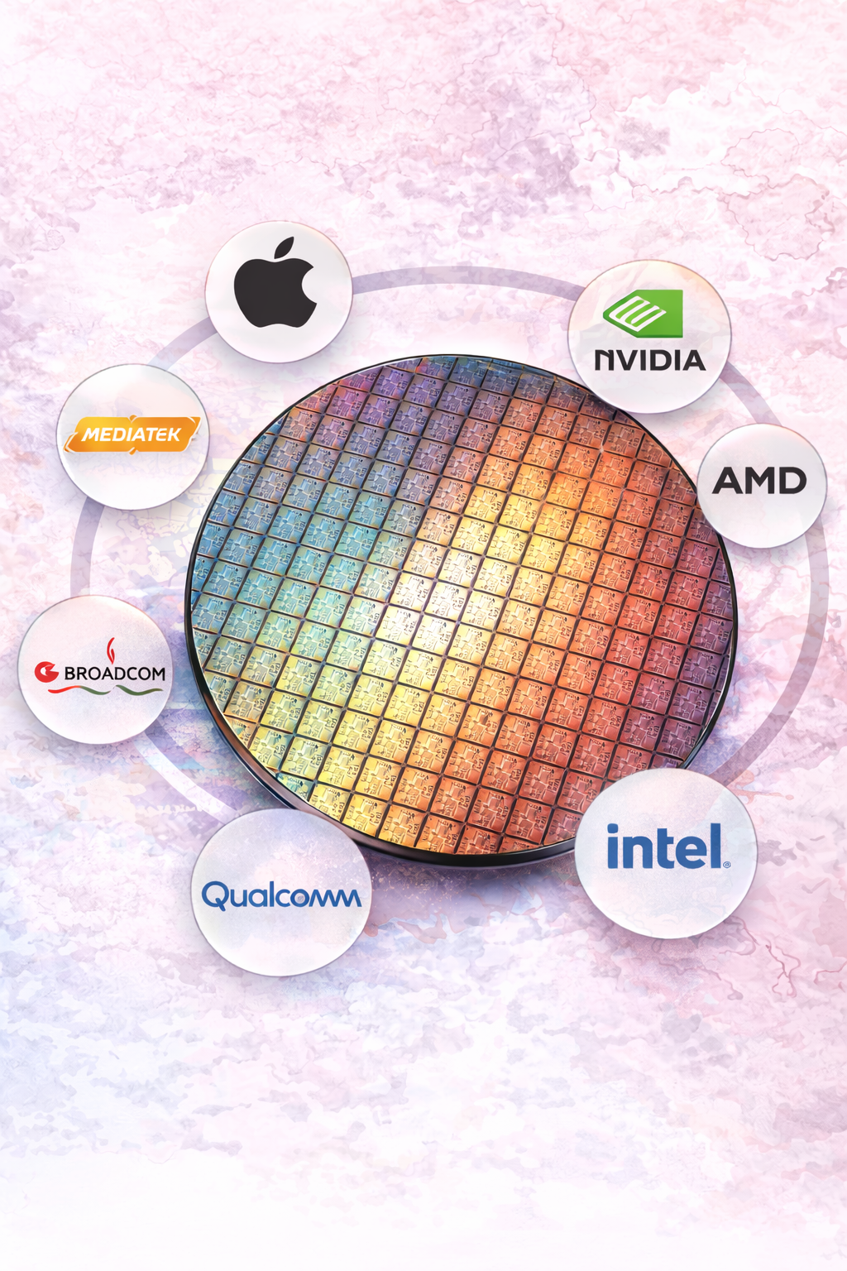
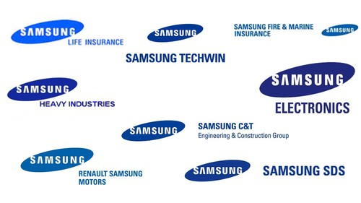
A Tale of Two Chips
The Conglomerate
The Foundry
Makes Everything
~ 20% Korea’s GDP
Makes One Thing
~ 70% Market Share
*Generated by ChatGPT

Slide 8
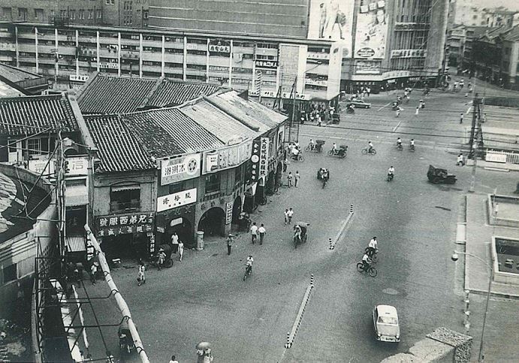
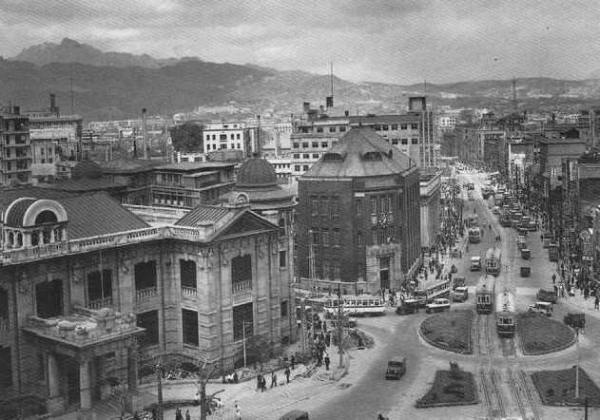
From The Same Starting Point
Circa 1960, both are:
Poor
Agricultural
Former Japanese colonies
No natural resources
Taipei in 1960s
Seoul in 1960s
Why did they develop such different economic “personalities”?

Slide 9

Political Economy: How Politics Shapes Markets
*Generated by ChatGPT

Slide 10
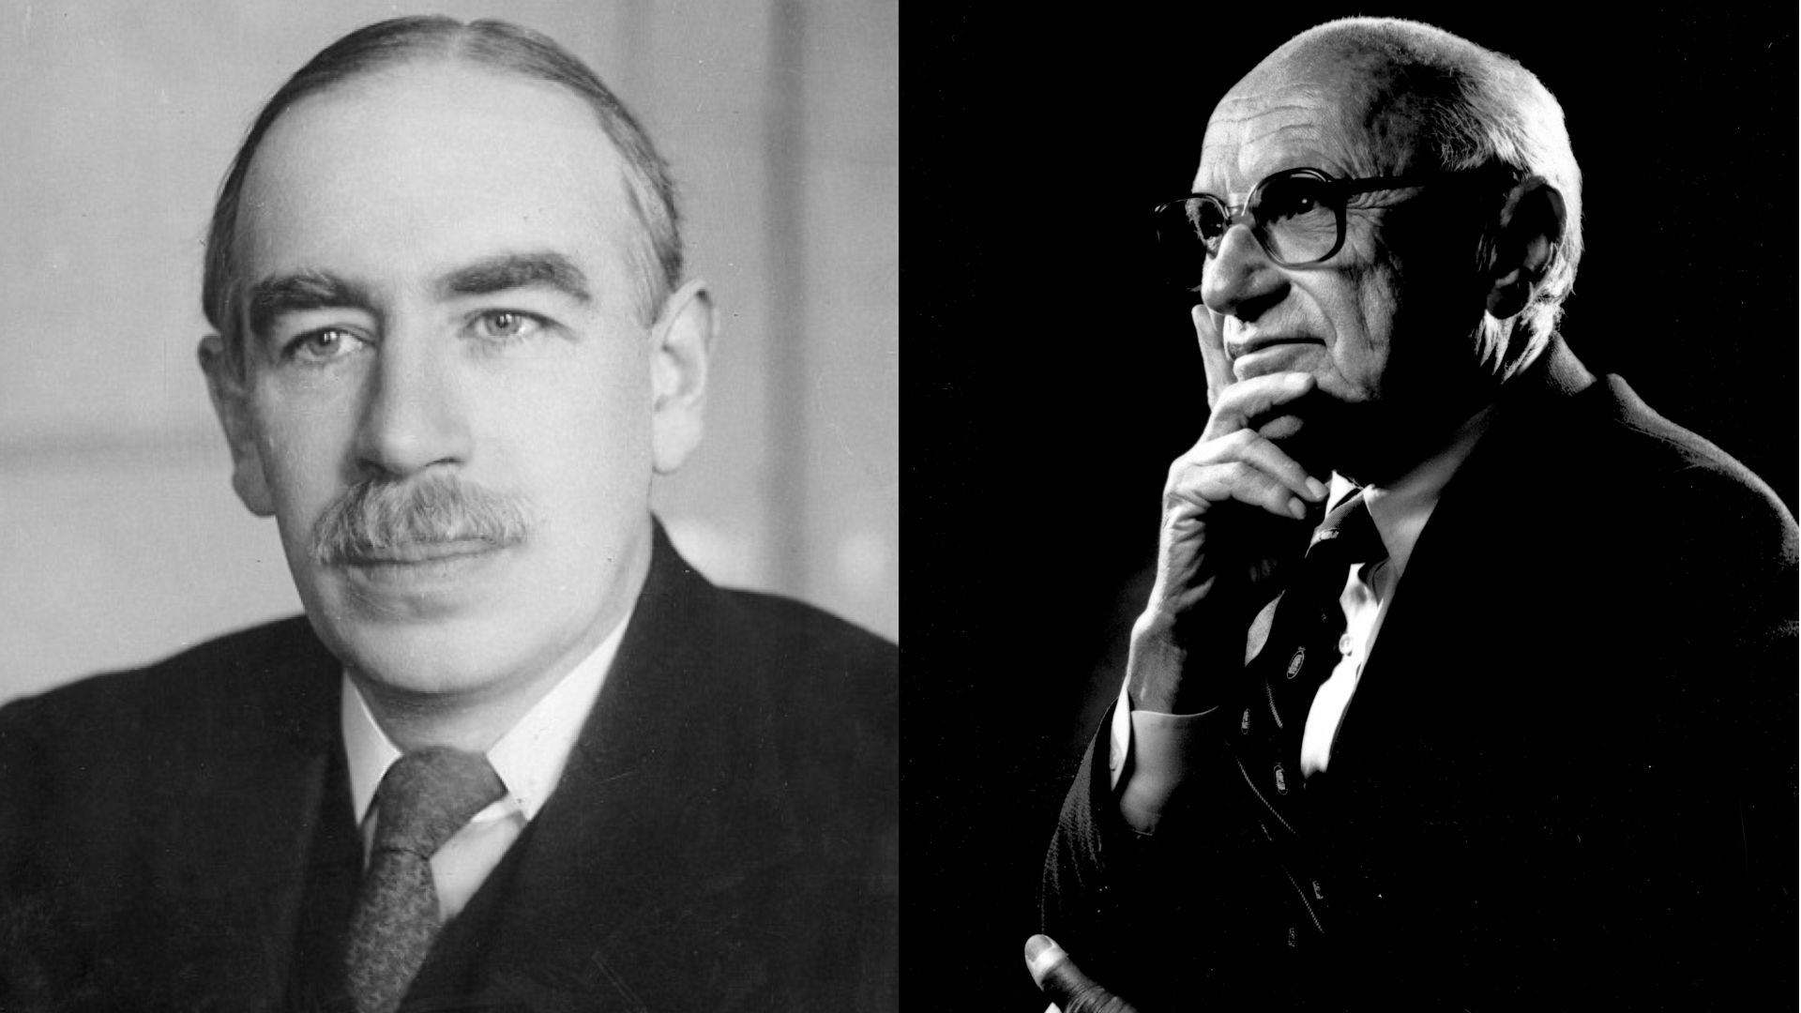
Political Economy: How Politics Shapes Markets
John Keynes
Milton Friedman
State Intervention
Free Market

Slide 11
The State Sets the Rules of the Game
State decides:
Who can invest
Which industries (firms) get support
What property rights look like
How open the economy is
…
How does the state make these economic decisions?
Politics!

Slide 12
How Political Incentives Shape Economic Outcomes
The Ultimate Political Incentive: Stay in Power
Depends on Political Institutions
Democracy: winning votes
Dictatorship: satisfying elite constituents
Military, big business, foreign interests, etc.
…

Slide 13
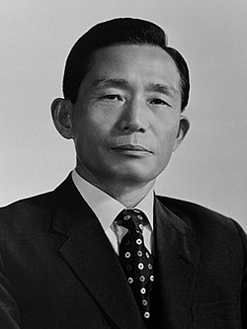
Foundation I: Political Institution
The Conglomerate
South Korea
Military regime (1963 – 1979)
Needed massive industrial scale to compete with North Korea
Create Chaebols by funneling national bank loans to a few loyal families
Park Chung-Hee

Slide 14
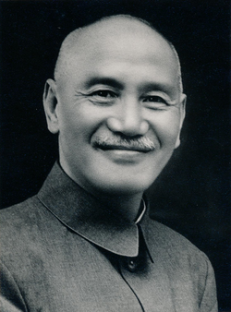
Foundation I: Political Institution
The Foundry
Taiwan
The KMT (Mainlanders)
Local Taiwanese
Suppressed large private groups
Focus on SMEs
State-incubated tech to keep control
ITRI (Institute for Industrial Technology Research)
Chiang Kai-Shek

Slide 15
The Political Economy Process
Political
Institutions
(rules & constraints)
Political
Incentives
(how to stay in power)
Economic
Policies
(shaped by incentives)
Economic
Outcomes
(growth, stability, etc.)

Slide 16
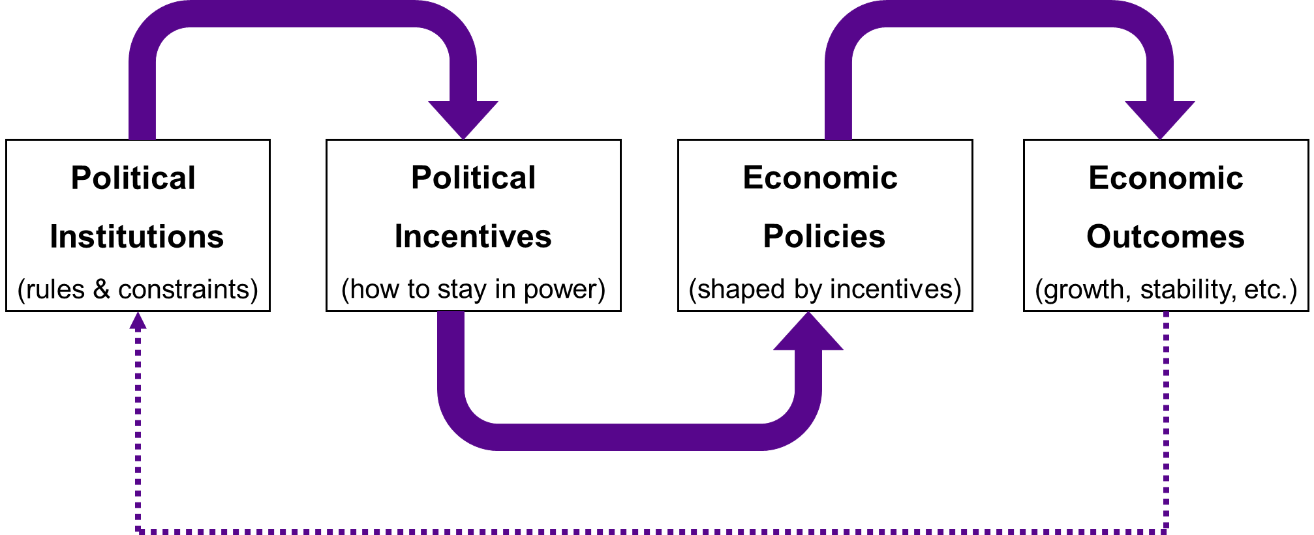
The Political Economy Process
History
Geopolitics

Slide 17
Foundation II: History
The Imperial Legacy of Japanese Colonialism
Initially: Taiwan and Korea as agricultural appendages
Early 1930s: War Preparation
Industrial development
Heavy industries
Economic infrastructure
Initial industrial foundation for Samsung and TSMC

Slide 18
Foundation III: Geopolitics
Cold War & US Hegemony
US (capitalism) vs. USSR (communism)
The East Asian Deal
US Provides Security + Markets
East Asian aligned against communism
Samsung and TSMC could access US technology and market

Slide 19
Methodology – Making Inferences
Comparative political economy
Two key designs: • Most Similar Systems Design (MSSD) • Most Different Systems Design (MDSD)

Slide 20
Most Similar Systems Design
The Conglomerate
The Foundry
South Korea vs. Taiwan
Similar
History
Culture
Geopolitics
…
Different
Political system (state strategy)

Slide 21
Most Different Systems Design
Japan vs. China
Different
History
Ideology
Political system
Geopolitics
Development stage
…
Similar
…
Common Choice
State-led industrial policy
Export-oriented growth

Slide 22
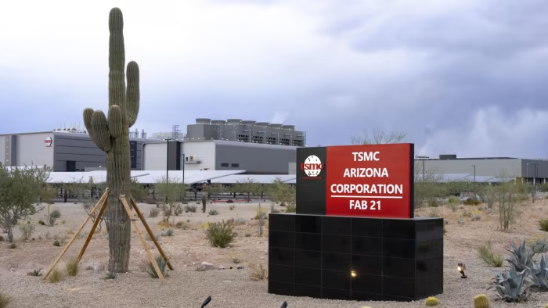
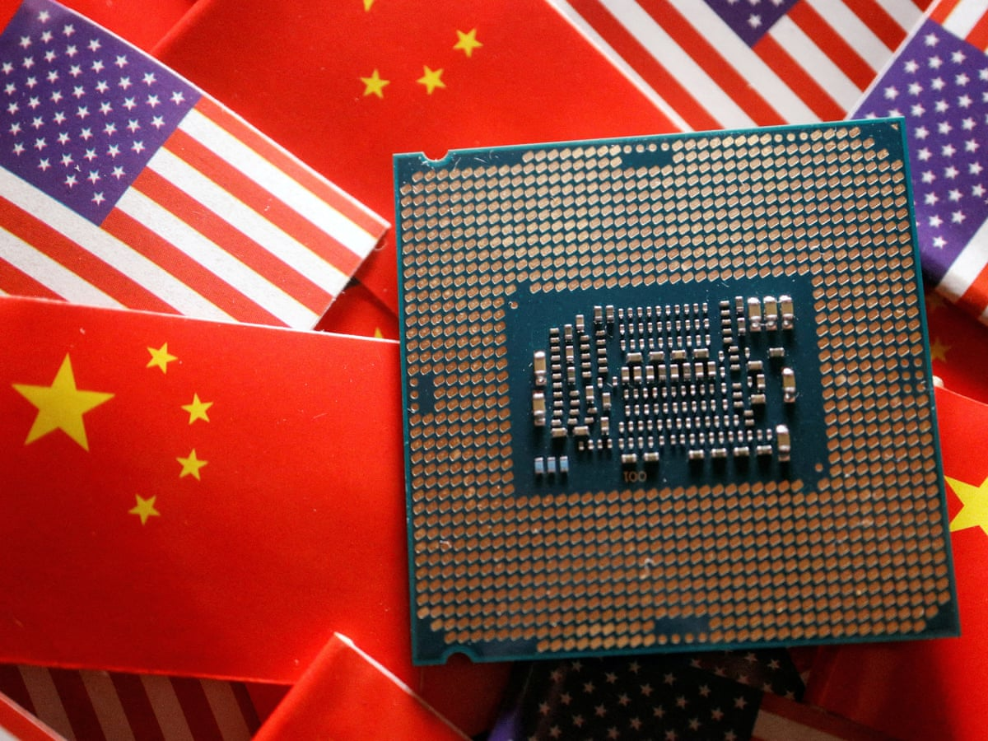
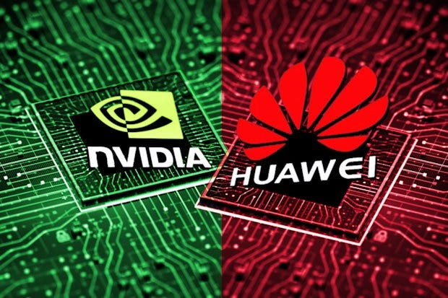
Back to the Future
Summary:
History provided the base.
Political Institutions decided the strategy.
Geopolitics provided the opportunity.

Slide 23

Thank You!

